Slide 1

Unit-4 3D Concepts & Object Representation

Slide 2
Outline
3D Display Methods
Polygon Surfaces
Polygon Table
Plane Equation
Polygon Meshes
Spline Representation
Cubic Spline Interpolation Methods
Bazier Curves and Surfaces
B-spline Curves and Surfaces

Slide 3
3D Display Methods
Methods used for three dimensional display is known as 3D display methods, which are,
Parallel projection
Perspective projection
Depth cueing
Visible line and surface identification
Surface rendering
Exploded and cutaway views

Slide 4
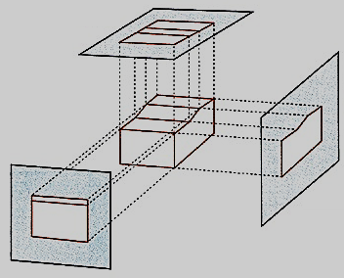
1. Parallel Projection
This method generates view from solid object by projecting parallel lines onto the display plane.
By changing viewing position we can get different views of 3D object onto 2D display screen.
This technique is used in Engineering & Architecture drawing.
Example :- Orthographic projection.

Slide 5
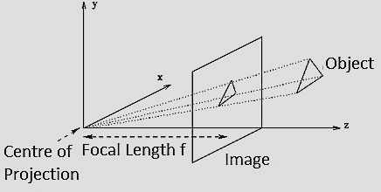
2. Perspective Projection
This method generating view of 3D object by projecting point on the display plane along converging paths.
This will display object smaller when it is away from the view plane and of nearly same size when closer to view plane.
It will produce more realistic view as it is the way our eye is forming image.

Slide 6
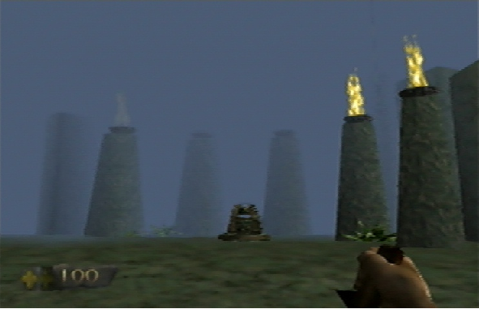
3. Depth cueing
Many times depth information is important.
Simple method to do this is depth cueing in which assign higher intensity to closer object & lower intensity to the far objects.

Slide 7
Contd.
Depth cuing is applied by choosing maximum and minimum intensity values and a range of distance over which the intensities are to vary.
Using it we can identify for a particular viewing direction which are the front surfaces and which are the back surfaces of display object.
Another application is to modeling effect of atmosphere.

Slide 8
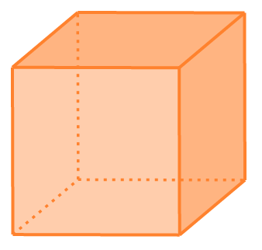
4. Visible line and surface identification
In this method we first identify visible lines or surfaces by some method.
Then display visible lines with highlighting or with some different color.
Other way is to display hidden lines with dashed lines or simply not display hidden lines.

Slide 9
Contd.
Not drawing hidden lines will loss the some information.
Similar method we can apply for the surface also by displaying shaded surface or color surface.
Some visible surface algorithm establishes visibility pixel by pixel across the view plane.
Other determines visibility of object surface as a whole.

Slide 10
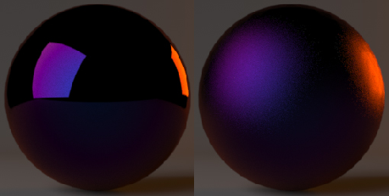
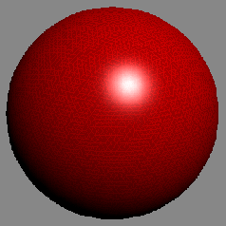
5. Surface Rendering
Realistic image is produce by setting surface intensity according to light reflect from that surface & the characteristics of that surface.
It will give more intensity to the shiny surface and less to dull surface.
It also applies high intensity where light is more & less where light falls is less.

Slide 11
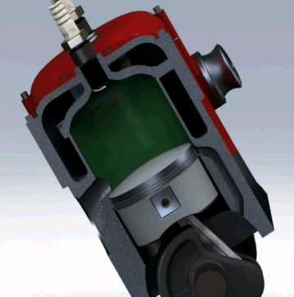
6. Exploded and cutaway views
Many times internal structure of the object is need to store. Example:- in machine drawing internal assembly is important.
For displaying such views it will remove (cutaway) upper cover of body so that internal part’s can be visible.
Source: https://i.ytimg.com

Slide 12
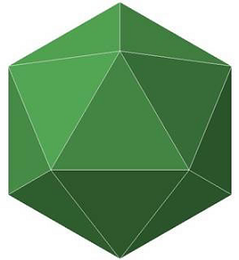
Polygon Surfaces
A polygonal surface can be thought of as a surface composed of polygonal faces.
The most commonly used boundary representation for a 3D object is a set of polygon surfaces that enclose the object interior.
Polygon surfaces are represented in computer by different methods, which are,
Polygon Tables
Plane Equations
Polygon Meshes

Slide 13
1. Polygon Tables
Representation of vertex coordinates, edges and other property of polygon into table form is called polygon table.
Polygon data tables can be organized into two groups:
geometric table
attributes table.
Geometric table contains vertex coordinate and the other parameter which specify geometry of polygon.
Attributes table stores other information like color, transparency etc.
Convenient way to represent geometric table into three different table namely vertex table, edge table, and polygon table.

Slide 14



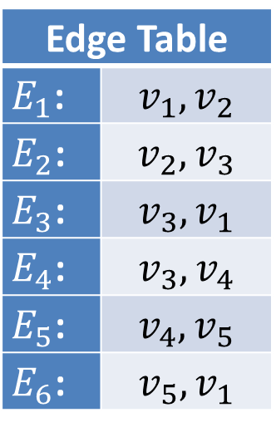



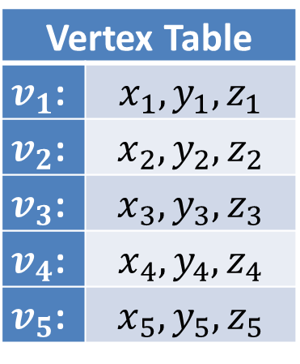






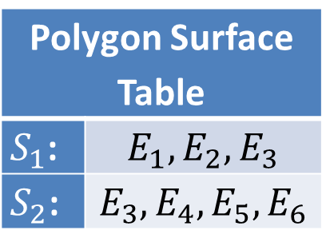


Contd.
$$v_{1}$$
$$(x_{1},y_{1},z_{1})$$
Vertex Table
$v_{1}$: | $$x_{1},y_{1},z_{1}$$
$v_{2}$: | $$x_{2},y_{2},z_{2}$$
$v_{3}$: | $$x_{3},y_{3},z_{3}$$
$v_{4}$: | $$x_{4},y_{4},z_{4}$$
$v_{5}$: | $$x_{5},y_{5},z_{5}$$
Edge Table
$E_{1}$: | $$v_{1},v_{2}$$
$E_{2}$: | $$v_{2},v_{3}$$
$E_{3}$: | $$v_{3},v_{1}$$
$E_{4}$: | $$v_{3},v_{4}$$
$E_{5}$: | $$v_{4},v_{5}$$
$E_{6}$: | $$v_{5},v_{1}$$
$$E_{1}$$
$$E_{3}$$
$$v_{2}$$
$$S_{1}$$
$$E_{6}$$
$$E_{2}$$
$$v_{3}$$
$$S_{2}$$
$$v_{5}$$
$$E_{4}$$
$$E_{5}$$
$$v_{4}$$
Polygon Surface Table
$S_{1}$: | $$E_{1},E_{2},E_{3}$$
$S_{2}$: | $$E_{3},E_{4},E_{5},E_{6}$$

Slide 15





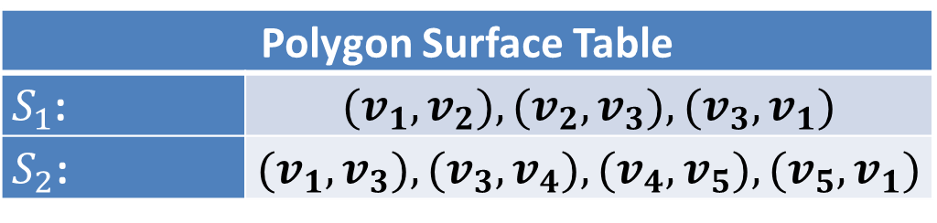

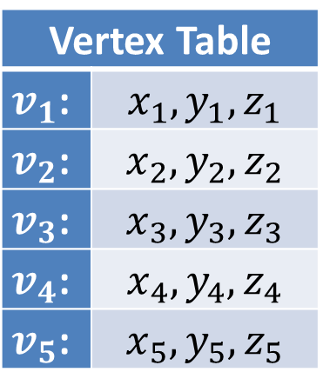








Contd.
Another way to represent with two table vertex table and polygon table.
Vertex Table
$v_{1}$: | $$x_{1},y_{1},z_{1}$$
$v_{2}$: | $$x_{2},y_{2},z_{2}$$
$v_{3}$: | $$x_{3},y_{3},z_{3}$$
$v_{4}$: | $$x_{4},y_{4},z_{4}$$
$v_{5}$: | $$x_{5},y_{5},z_{5}$$
$$v_{1}$$
$$(x_{1},y_{1},z_{1})$$
$$E_{1}$$
$$v_{2}$$
$$E_{3}$$
$$S_{1}$$
$$E_{6}$$
$$E_{2}$$
$$v_{3}$$
$$S_{2}$$
$$v_{5}$$
$$E_{4}$$
$$E_{5}$$
$$v_{4}$$
Polygon Surface Table
$S_{1}$: | $$(v_{1},v_{2}),(v_{2},v_{3}),(v_{3},v_{1})$$
$S_{2}$: | $$(v_{1},v_{3}),(v_{3},v_{4}),(v_{4},v_{5}),(v_{5},v_{1})$$

Slide 16
Contd.
Two table representation is inefficient as it will store common edge multiple times.
Sometimes it may be possible that errors may occurs during input.
For dealing with that we add extra information into tables.
For example edge table with
information of the surface
in which particular edge is
present.
E1: | V1, V2, S1
E2: | V2, V3, S1
E3: | V3, V1, S1, S2
E4: | V3, V4, S2
E5: | V4, V5, S2
E6: | V5, V1, S2

Slide 17
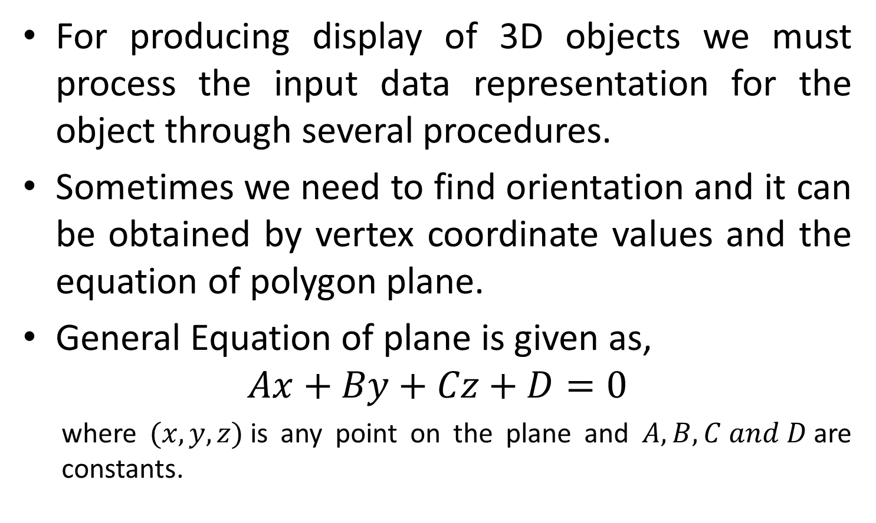
2. Plane Equations
For producing display of 3D objects we must process the input data representation for the object through several procedures.
Sometimes we need to find orientation and it can be obtained by vertex coordinate values and the equation of polygon plane.
General Equation of plane is given as,
$$Ax+By+Cz+D=0$$
where $(x, y, z)$is any point on the plane and $A, B, C and D$are constants.

Slide 18
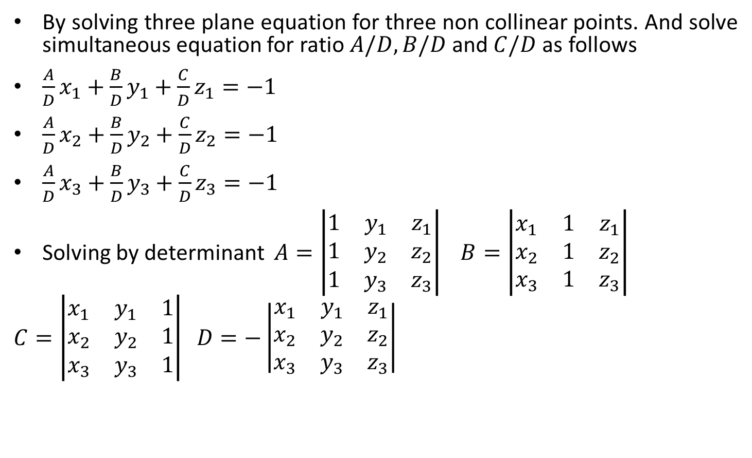
Contd.
By solving three plane equation for three non collinear points. And solve simultaneous equation for ratio $A/D, B/D$and $C/D$ as follows
$\frac{A}{D}x_{1}+\frac{B}{D}y_{1}+\frac{C}{D}z_{1}=−1$
$\frac{A}{D}x_{2}+\frac{B}{D}y_{2}+\frac{C}{D}z_{2}=−1$
$\frac{A}{D}x_{3}+\frac{B}{D}y_{3}+\frac{C}{D}z_{3}=−1$
Solving by determinant $A=\left|\begin{matrix}1 & y_{1} & z_{1} \\ 1 & y_{2} & z_{2} \\ 1 & y_{3} & z_{3}\end{matrix}\right| B=\left|\begin{matrix}x_{1} & 1 & z_{1} \\ x_{2} & 1 & z_{2} \\ x_{3} & 1 & z_{3}\end{matrix}\right|$
$$C=\left|\begin{matrix}x_{1} & y_{1} & 1 \\ x_{2} & y_{2} & 1 \\ x_{3} & y_{3} & 1\end{matrix}\right| D=−\left|\begin{matrix}x_{1} & y_{1} & z_{1} \\ x_{2} & y_{2} & z_{2} \\ x_{3} & y_{3} & z_{3}\end{matrix}\right|$$

Slide 19
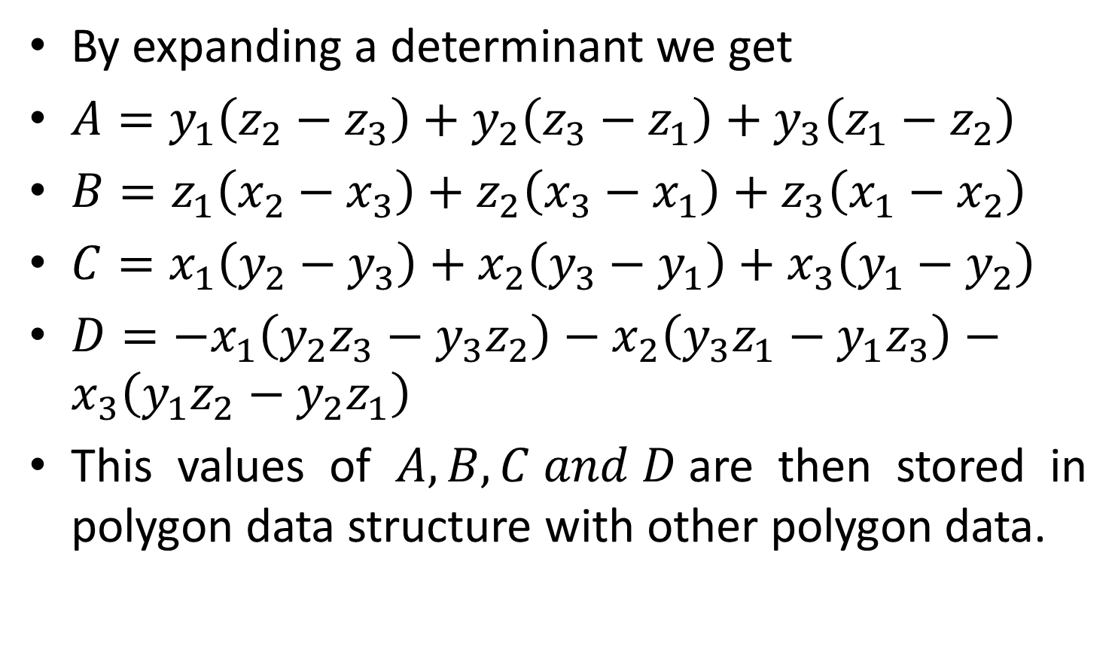
Contd.
By expanding a determinant we get
$A=y_{1}\left(z_{2}−z_{3}\right)+y_{2}\left(z_{3}−z_{1}\right)+y_{3}\left(z_{1}−z_{2}\right)$
$B=z_{1}\left(x_{2}−x_{3}\right)+z_{2}\left(x_{3}−x_{1}\right)+z_{3}\left(x_{1}−x_{2}\right)$
$C=x_{1}\left(y_{2}−y_{3}\right)+x_{2}\left(y_{3}−y_{1}\right)+x_{3}\left(y_{1}−y_{2}\right)$
$D=−x_{1}\left(y_{2}z_{3}−y_{3}z_{2}\right)−x_{2}\left(y_{3}z_{1}−y_{1}z_{3}\right)−x_{3}\left(y_{1}z_{2}−y_{2}z_{1}\right)$
This values of $A, B, C and D$are then stored in polygon data structure with other polygon data.

Slide 20

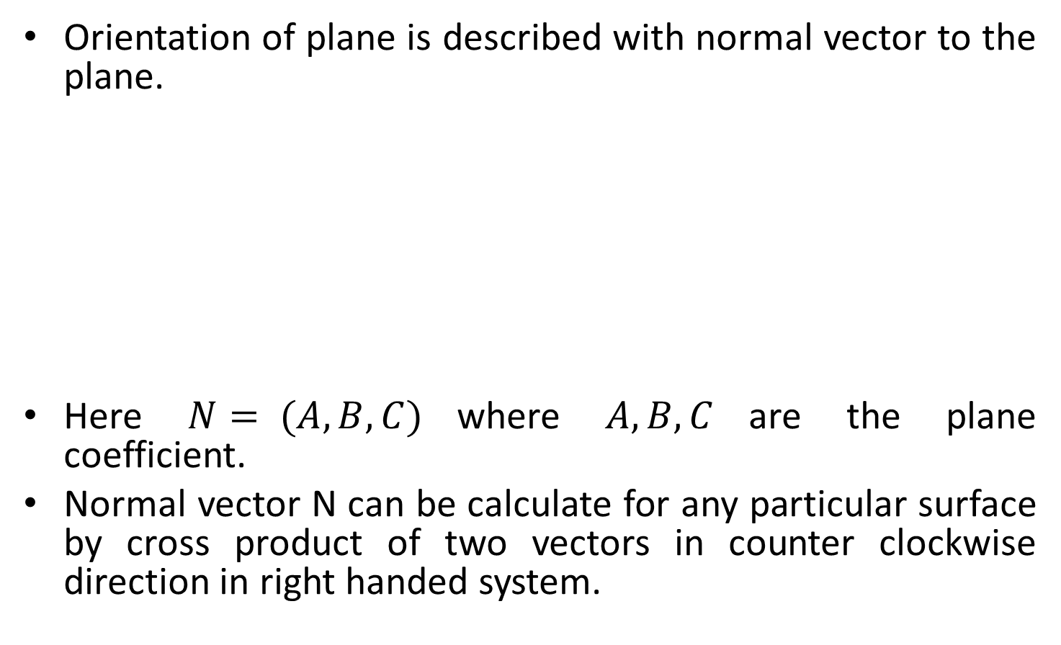



Orientation of Plane
Orientation of plane is described with normal vector to the plane.
Here $N= (A,B,C)$where $A, B, C$are the plane coefficient.
Normal vector N can be calculate for any particular surface by cross product of two vectors in counter clockwise direction in right handed system.
$$N= (A, B, C)$$
$$Y$$
$$X$$
$$Z$$

Slide 21
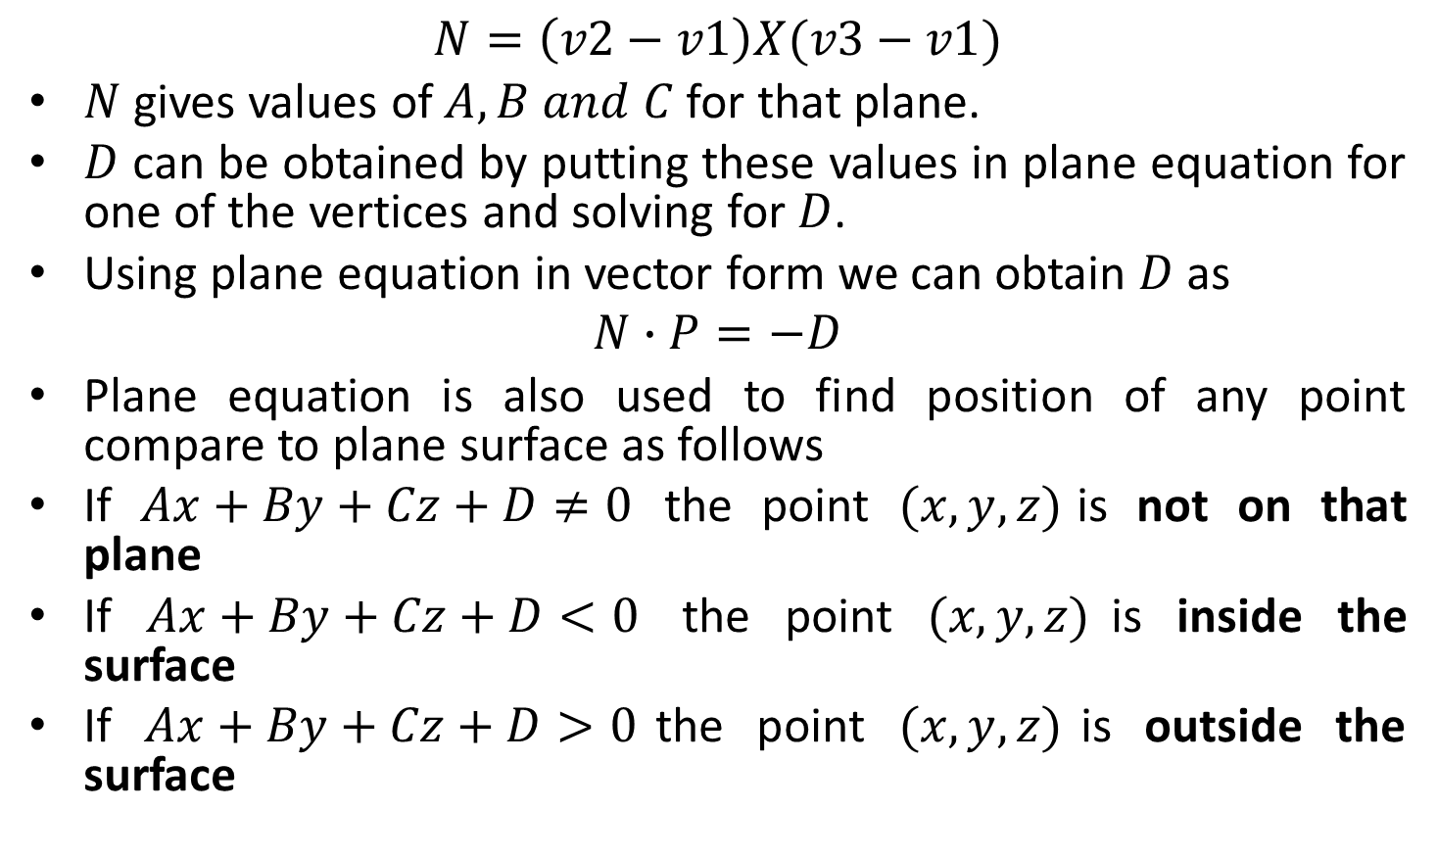
Contd.
$$N=\left(v2−v1\right)X(v3−v1)$$
$N$gives values of $A, B and C$for that plane.
$D$ can be obtained by putting these values in plane equation for one of the vertices and solving for $D$.
Using plane equation in vector form we can obtain $D$ as
$$N∙P=−D$$
Plane equation is also used to find position of any point compare to plane surface as follows
If $Ax+By+Cz+D≠0$ the point $(x,y,z)$is not on that plane
If $Ax+By+Cz+D<0$ the point $(x,y,z)$is inside the surface
If $Ax+By+Cz+D>0$the point $(x,y,z)$is outside the surface

Slide 22
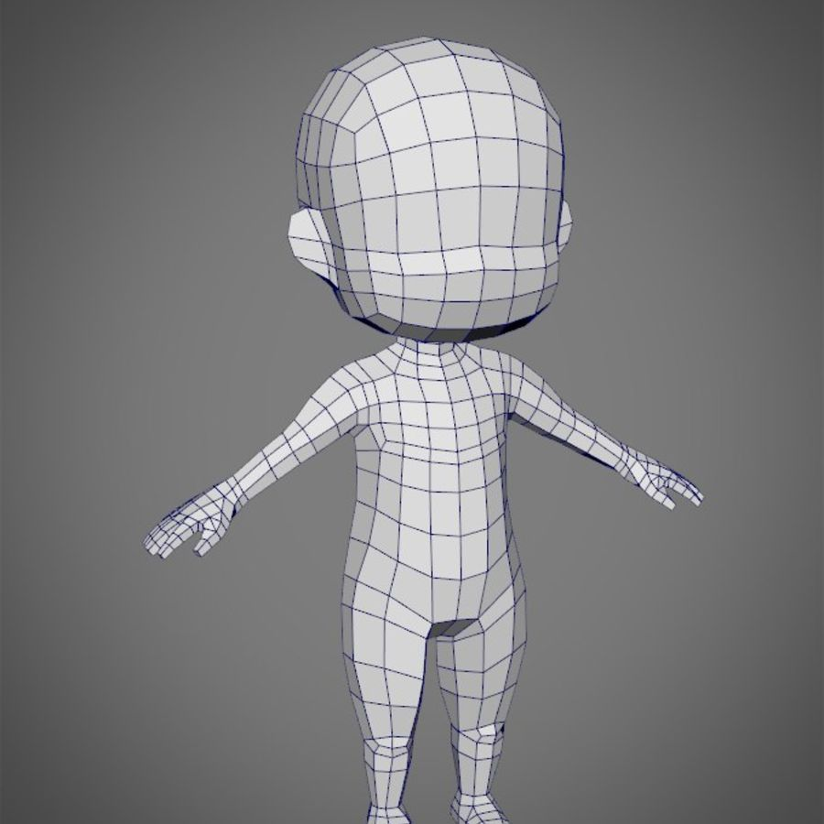
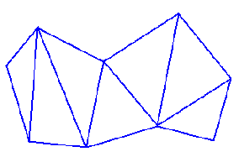
3. Polygon Meshes
Polygon mesh is a collection of edges, vertices and faces that defines the shape of the polyhedral object in 3D computer graphics and solid modeling.
An edge can be shared by two or more polygons.
Vertex is shared by at least two edges.
Polygon mesh is represented in following ways
Explicit representation
Pointer to vertex list
Pointer to edge list

Slide 23



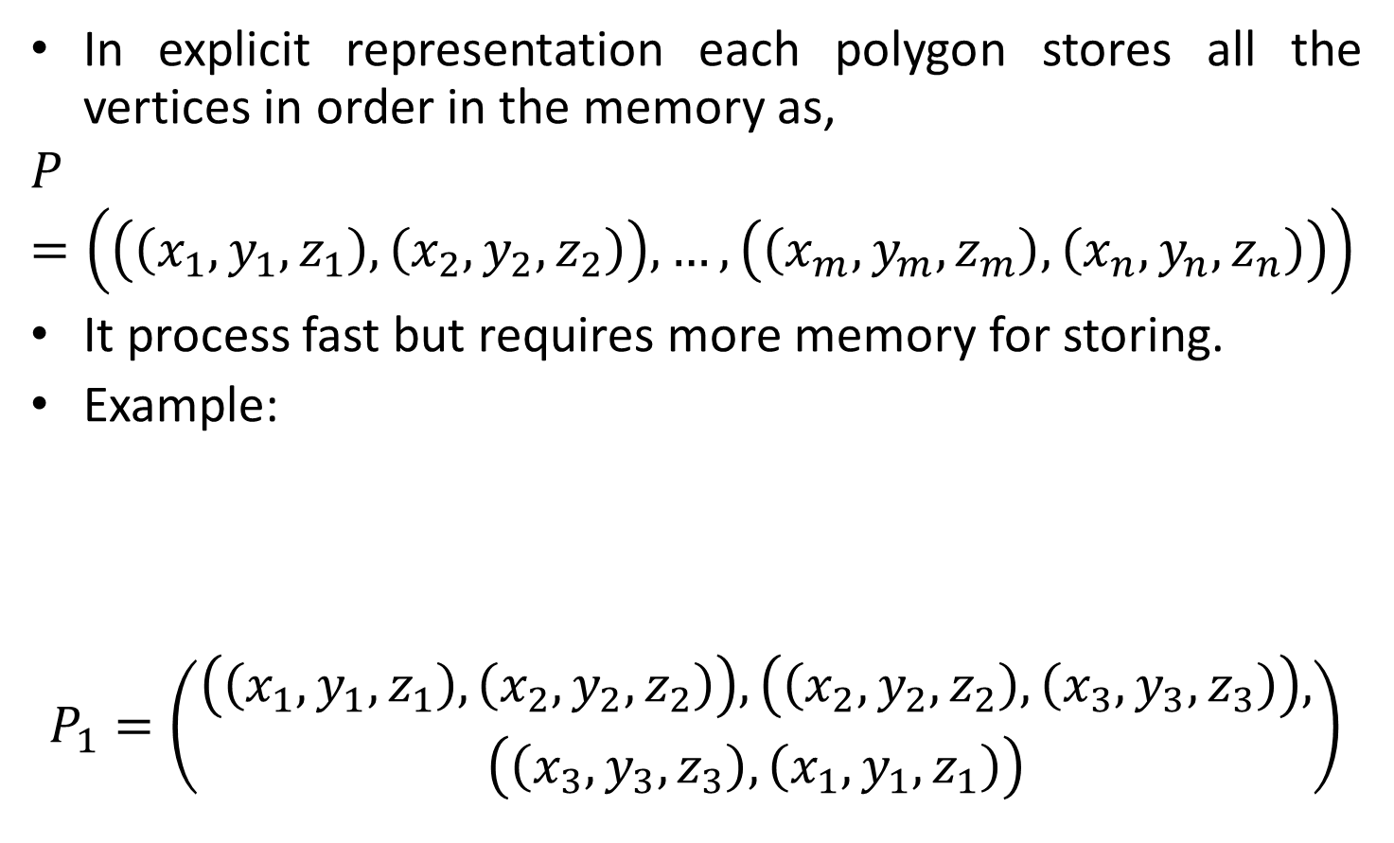




Explicit Representation-Polygon Meshes
In explicit representation each polygon stores all the vertices in order in the memory as,
$$P=\left(\left(\left(x_{1},y_{1},z_{1}\right),\left(x_{2},y_{2},z_{2}\right)\right),…,\left(\left(x_{m},y_{m},z_{m}\right),\left(x_{n},y_{n},z_{n}\right)\right)\right)$$
It process fast but requires more memory for storing.
Example:
$$P_{1}=\left(\begin{aligned}\left(\left(x_{1},y_{1},z_{1}\right),\left(x_{2},y_{2},z_{2}\right)\right),\left(\left(x_{2},y_{2},z_{2}\right),\left(x_{3},y_{3},z_{3}\right)\right), \\ \left(\left(x_{3},y_{3},z_{3}\right),\left(x_{1},y_{1},z_{1}\right)\right)\end{aligned}\right)$$
$$v_{1}$$
$$\left(x1,y1,z1\right)$$
$$P_{2}$$
$$v_{4}$$
$$P_{1}$$
$$v_{2}$$
$$v_{3}$$

Slide 24



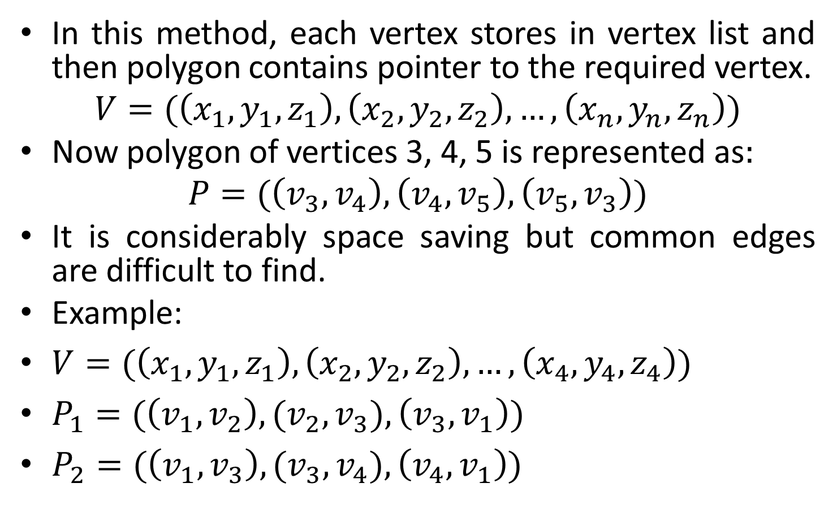




Pointer to Vertex List-Polygon Meshes
In this method, each vertex stores in vertex list and then polygon contains pointer to the required vertex.
$$V=(\left(x_{1},y_{1},z_{1}\right),\left(x_{2},y_{2},z_{2}\right),…,\left(x_{n},y_{n},z_{n}\right))$$
Now polygon of vertices 3, 4, 5 is represented as$:$
$$P=(\left(v_{3},v_{4}\right),\left(v_{4},v_{5}\right),\left(v_{5},v_{3}\right))$$
It is considerably space saving but common edges are difficult to find.
Example:
$V=(\left(x_{1},y_{1},z_{1}\right),\left(x_{2},y_{2},z_{2}\right),…,\left(x_{4},y_{4},z_{4}\right))$
$P_{1}=(\left(v_{1},v_{2}\right),{(v_{2},v}_{3}),\left(v_{3},v_{1}\right))$
$P_{2}=(\left(v_{1},v_{3}\right),{(v_{3},v}_{4}),\left(v_{4},v_{1}\right))$
$$v_{1}$$
$$\left(x1,y1,z1\right)$$
$$P_{2}$$
$$v_{4}$$
$$P_{1}$$
$$v_{2}$$
$$v_{3}$$

Slide 25





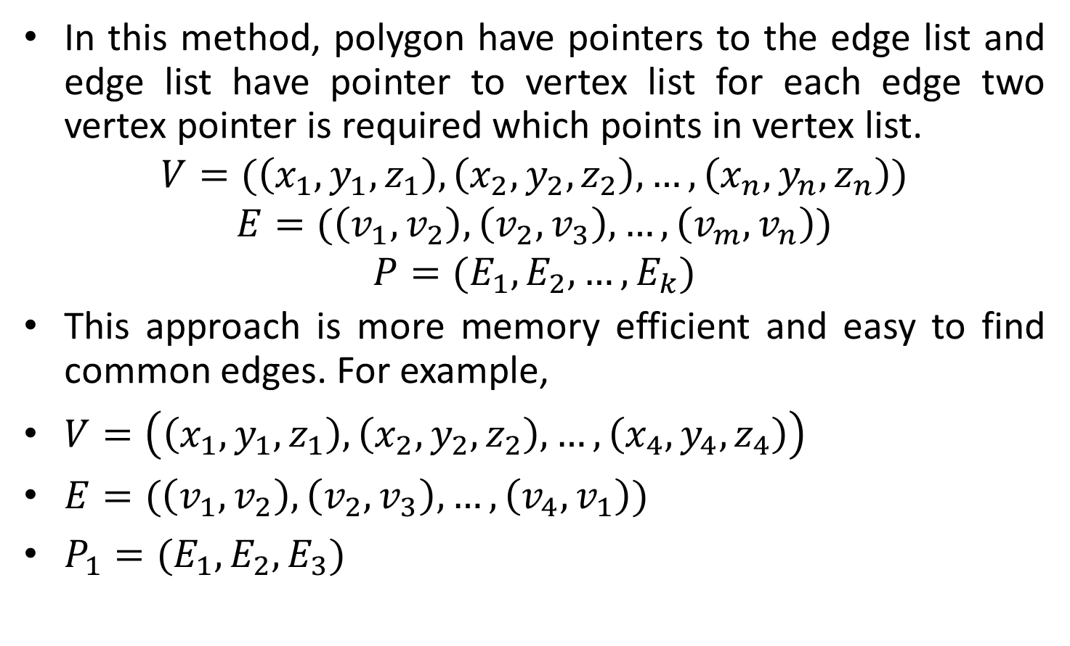







Pointer to Edge List-Polygon Meshes
In this method, polygon have pointers to the edge list and edge list have pointer to vertex list for each edge two vertex pointer is required which points in vertex list.
$$V=(\left(x_{1},y_{1},z_{1}\right),\left(x_{2},y_{2},z_{2}\right),…,\left(x_{n},y_{n},z_{n}\right))$$
$$E=(\left(v_{1},v_{2}\right),\left(v_{2},v_{3}\right),…,\left(v_{m},v_{n}\right))$$
$$P=(E_{1},E_{2},…,E_{k})$$
This approach is more memory efficient and easy to find common edges. For example,
$V=\left(\left(x_{1},y_{1},z_{1}\right),\left(x_{2},y_{2},z_{2}\right),…,\left(x_{4},y_{4},z_{4}\right)\right)$
$E=(\left(v_{1},v_{2}\right),\left(v_{2},v_{3}\right),…,\left(v_{4},v_{1}\right))$
$P_{1}=(E_{1},E_{2},E_{3})$
$$v_{1}$$
$$\left(x1,y1,z1\right)$$
$$E_{5}$$
$$E_{1}$$
$$P_{2}$$
$$v_{4}$$
$$E_{3}$$
$$P_{1}$$
$$E_{4}$$
$$v_{2}$$
$$E_{2}$$
$$v_{3}$$

Slide 26
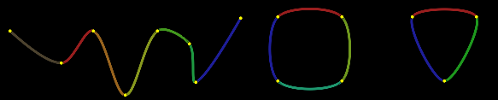
Spline Representations
Spline is flexible strip used to produce a smooth curve through a designated set of points.
Several small weights are attached to spline to hold in particular position.
Spline curve referred to any composite curve formed with polynomial sections satisfying specified continuity condition at the boundary of the pieces.
A spline surface
can be described
with two sets of
orthogonal spline
curves.

Slide 27
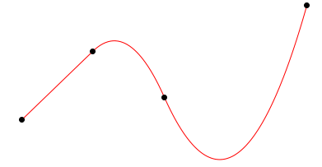
Interpolation and approximation splines
We specify spline curve by giving a set of coordinate positions called control points. This indicates the general shape of the curve.
When curve section passes through each control point, the curve is known as Interpolation Spline.
Interpolation

Slide 28
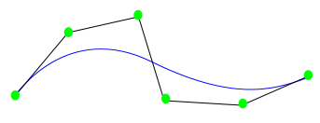
Interpolation and approximation splines
When curve section follows general control point path without necessarily passing through any control point, is known as Approximation Spline.
Approximation

Slide 29








Convex Hull
The convex polygon boundary that encloses a set of control points is called convex hull.
$$P_{2}$$
$$P_{2}$$
$$P_{0}$$
$$P_{0}$$
$$P_{3}$$
$$P_{3}$$
$$P_{1}$$
$$P_{1}$$

Slide 30








Control Graph
A poly line connecting the sequence of control points for an approximation spline is referred as control graph of the curve.
It is also referred as control polygon or characteristic polygon.
Usually displayed to remind a designer of the control points ordering
$$P_{2}$$
$$P_{2}$$
$$P_{0}$$
$$P_{0}$$
$$P_{3}$$
$$P_{3}$$
$$P_{1}$$
$$P_{1}$$

Slide 31
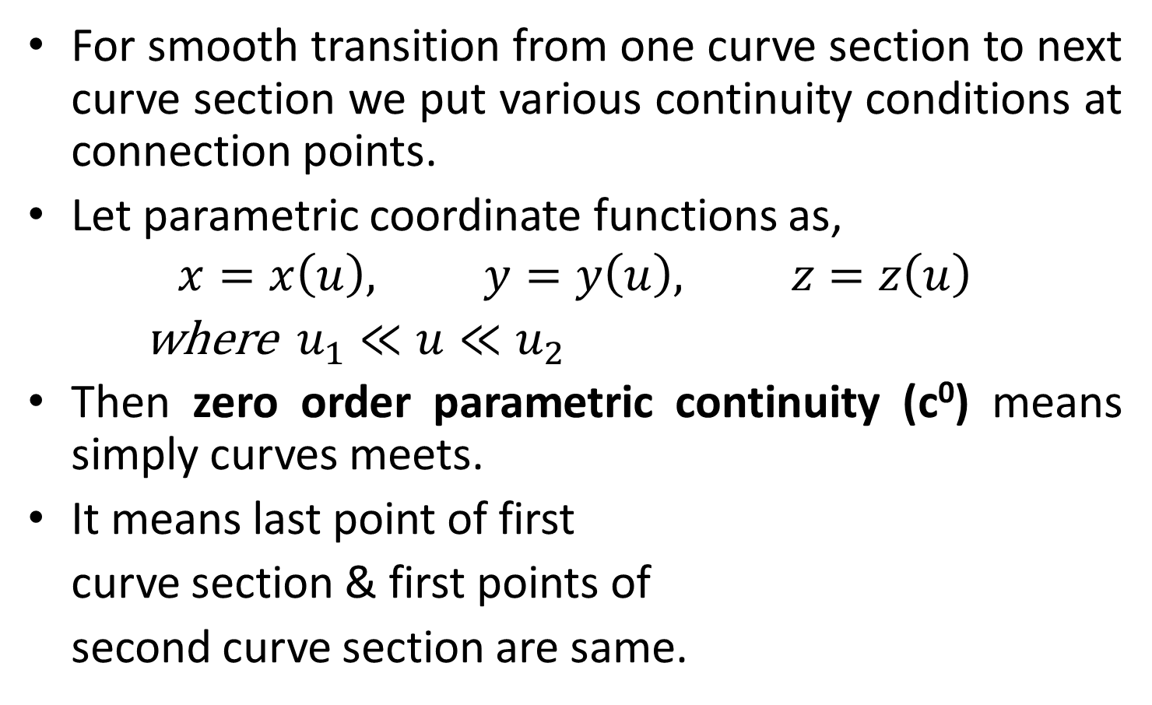
Parametric Continuity Condition
For smooth transition from one curve section to next curve section we put various continuity conditions at connection points.
Let parametric coordinate functions as,
$$x=x\left(u\right), y=y\left(u\right), z=z\left(u\right)$$
where $u_{1}≪u≪u_{2}$
Then zero order parametric continuity (c⁰) means simply curves meets.
It means last point of first
curve section & first points of
second curve section are same.

Slide 32
Contd.
First order parametric continuity (c¹) means first parametric derivatives are same for both curve section at intersection points.
Second order parametric continuity (c²) means both the first & second parametric derivative of two curve section are same at intersection.
Higher order parametric continuity is can be obtain similarly.
First order continuity is often sufficient for general application.
Some graphics package like cad requires second order continuity for accuracy.

Slide 33
Geometric continuity condition
Another method for joining two successive curve sections, is to specify condition for geometric continuity.
Zero order geometric continuity (g⁰) is same as parametric zero order continuity that two curve section meets.
First order geometric continuity (g¹) means that the parametric first derivatives are proportional at the intersection of two successive sections.
It is not necessary that its magnitude will be equal.
In other word, tangent direction must be same magnitude may differ.

Slide 34
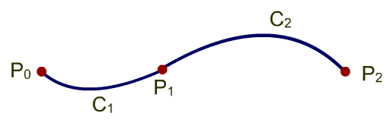
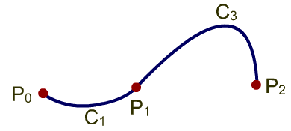
Contd.
Second order geometric continuity (g²) means that the both parametric first & second derivatives are proportional at the intersection of two successive sections.
It is not necessary that its magnitude will be equal.
With geometric continuity curve is pulled towards the section with the greater tangent vector.
Parametric continuity
Geometric continuity

Slide 35
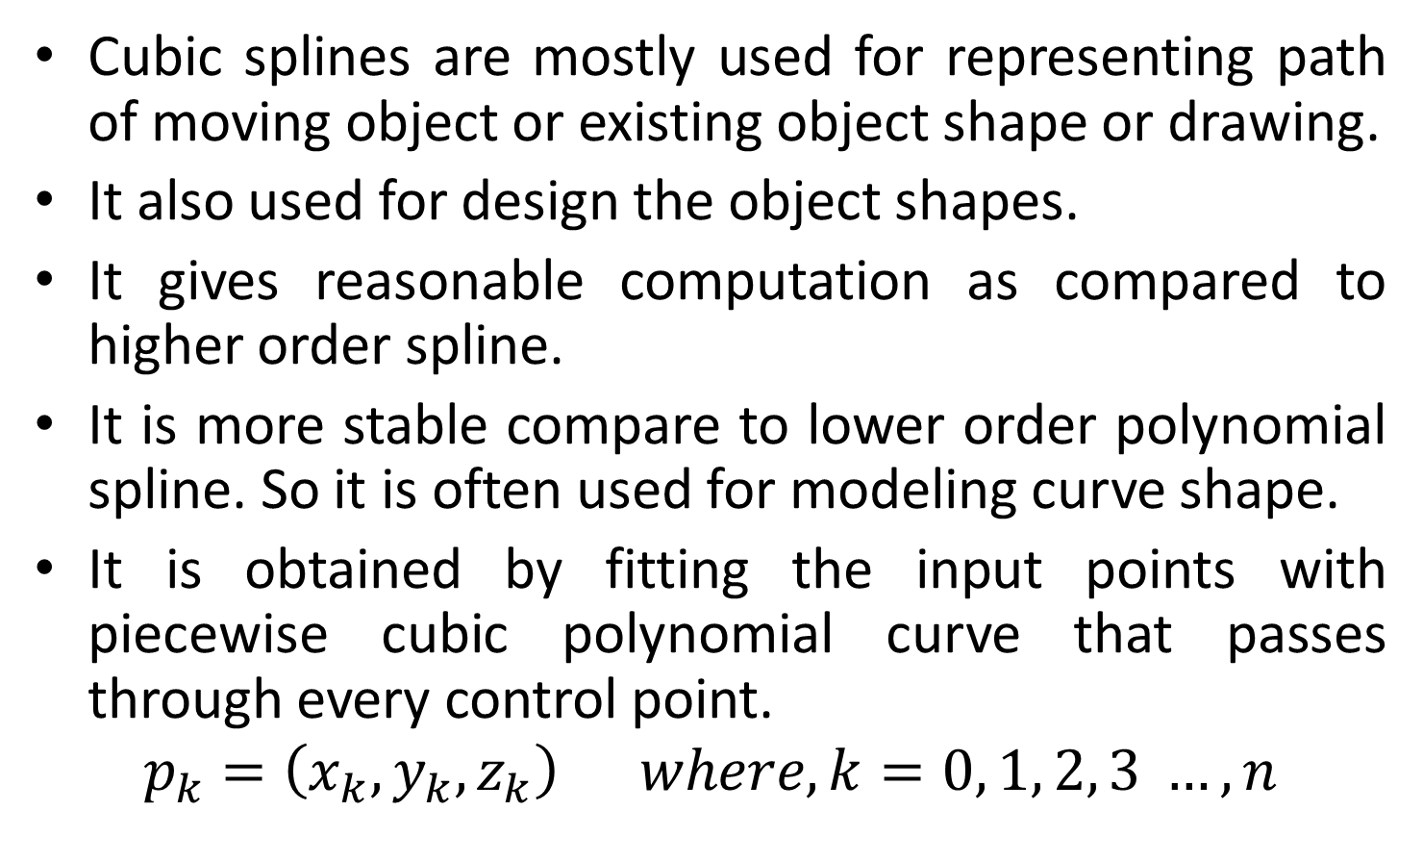
Cubic Spline Interpolation Methods
Cubic splines are mostly used for representing path of moving object or existing object shape or drawing.
It also used for design the object shapes.
It gives reasonable computation as compared to higher order spline.
It is more stable compare to lower order polynomial spline. So it is often used for modeling curve shape.
It is obtained by fitting the input points with piecewise cubic polynomial curve that passes through every control point.
$$p_{k}=\left(x_{k},y_{k},z_{k}\right) where, k=0, 1, 2, 3 …, n$$

Slide 36
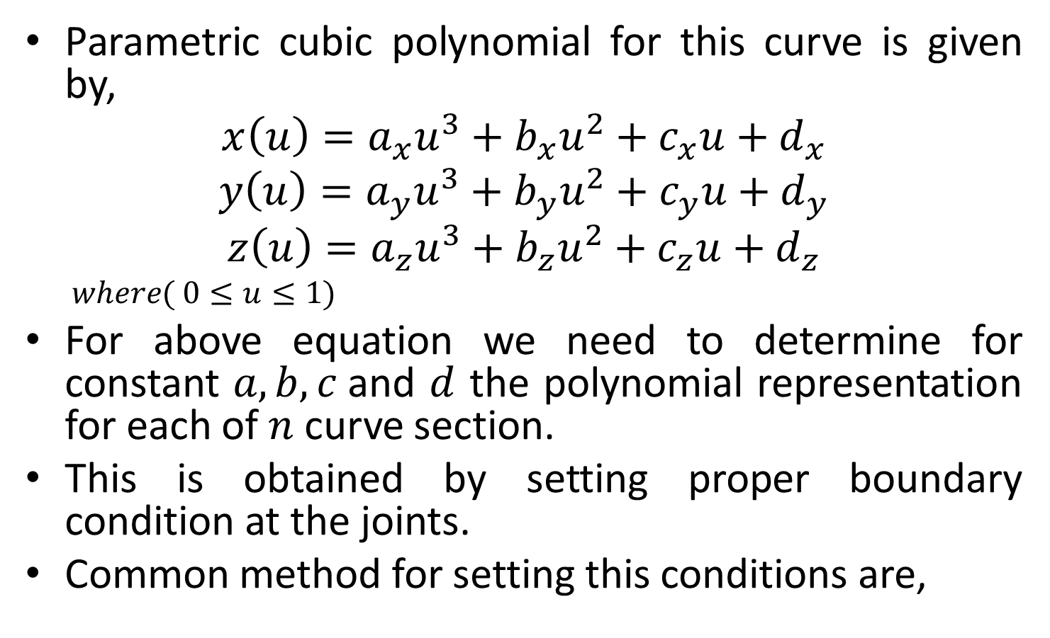
Contd.
Parametric cubic polynomial for this curve is given by,
$$x\left(u\right)=a_{x}u^{3}+b_{x}u^{2}+c_{x}u+d_{x}$$
$$y\left(u\right)=a_{y}u^{3}+b_{y}u^{2}+c_{y}u+d_{y}$$
$$z\left(u\right)=a_{z}u^{3}+b_{z}u^{2}+c_{z}u+d_{z}$$
$$where( 0≤u≤1)$$
For above equation we need to determine for constant $a, b, c$and $d$ the polynomial representation for each of $n$ curve section.
This is obtained by setting proper boundary condition at the joints.
Common method for setting this conditions are,
1. | Natural Cubic splines | 2. | Hermit interpolation
3. | Cardinal Splines | 4. | Kochanek-Bartels spline

Slide 37

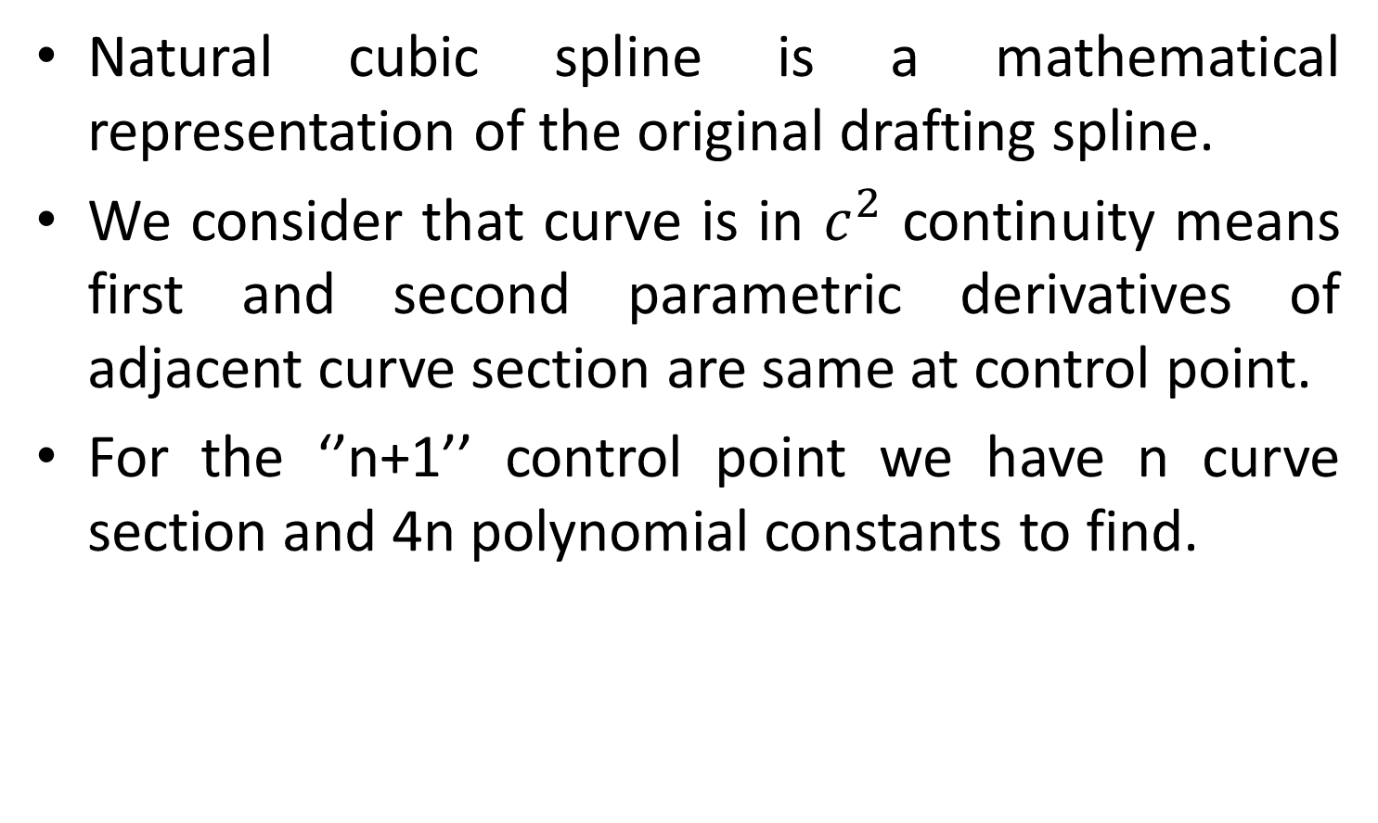



1. Natural Cubic Splines
Natural cubic spline is a mathematical representation of the original drafting spline.
We consider that curve is in $c^{2}$ continuity means first and second parametric derivatives of adjacent curve section are same at control point.
For the ‘’n+1’’ control point we have n curve section and 4n polynomial constants to find.
$$p_{1}$$
$$p_{n}$$
$$p_{0}$$
$$p_{2}$$

Slide 38

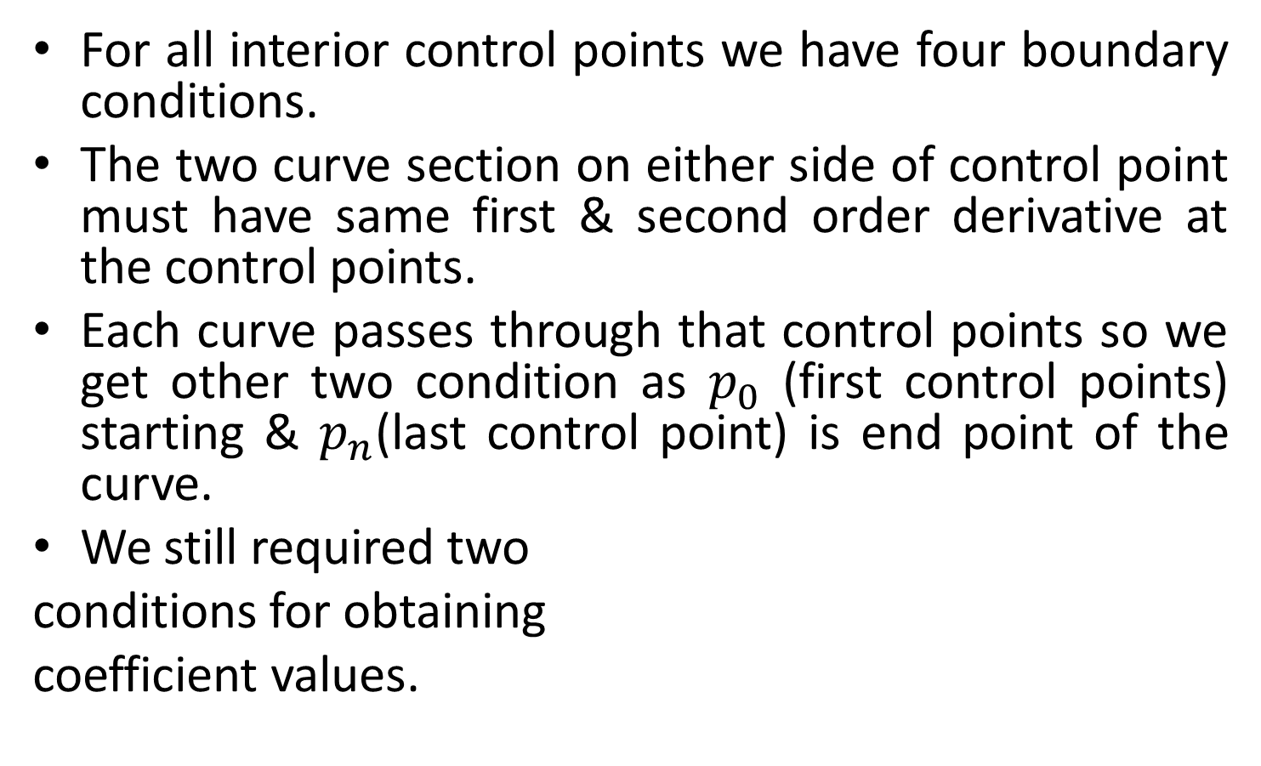
Contd.
For all interior control points we have four boundary conditions.
The two curve section on either side of control point must have same first & second order derivative at the control points.
Each curve passes through that control points so we get other two condition as $p_{0}$ (first control points) starting & $p_{n}$(last control point) is end point of the curve.
We still required two
conditions for obtaining
coefficient values.
$$p_{1}$$
$$p_{n}$$
$$p_{0}$$
$$p_{2}$$

Slide 39


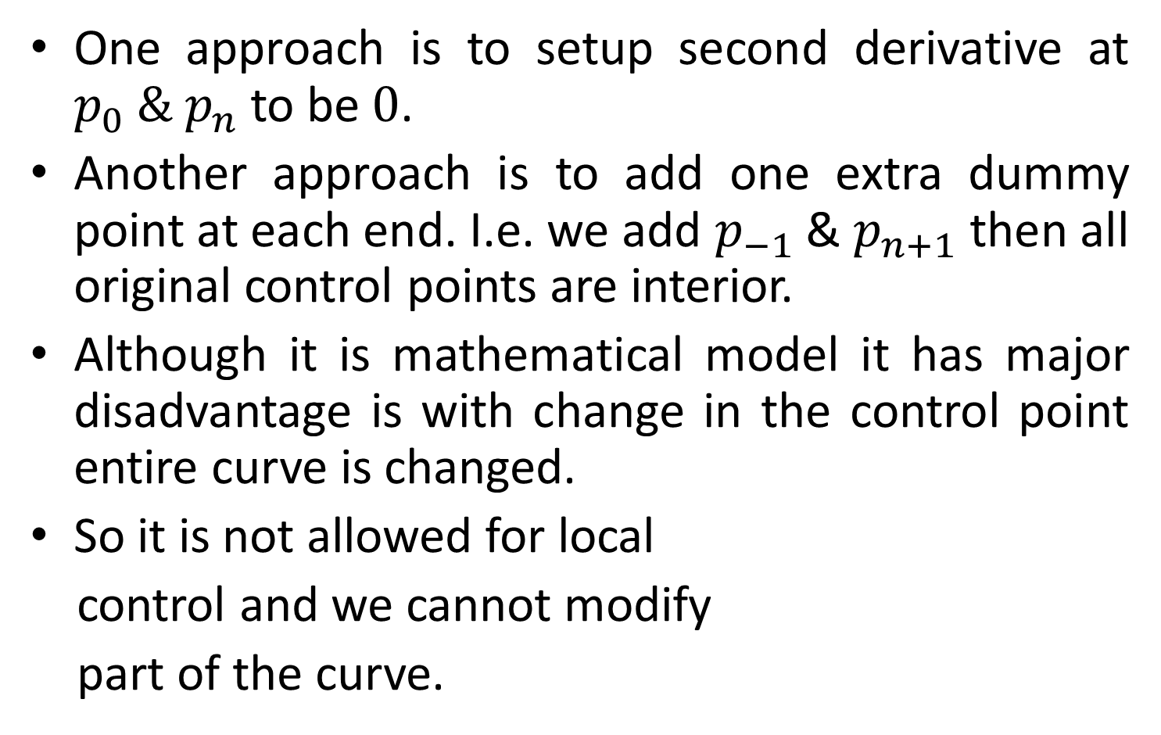

Contd.
One approach is to setup second derivative at $p_{0} \& p_{n}$ to be $0$.
Another approach is to add one extra dummy point at each end. I.e. we add $p_{−1}$ & $p_{n+1}$ then all original control points are interior.
Although it is mathematical model it has major disadvantage is with change in the control point entire curve is changed.
So it is not allowed for local
control and we cannot modify
part of the curve.
$$p_{1}$$
$$p_{n}$$
$$p_{0}$$
$$p_{n+1}$$
$$p_{−1}$$
$$p_{2}$$

Slide 40
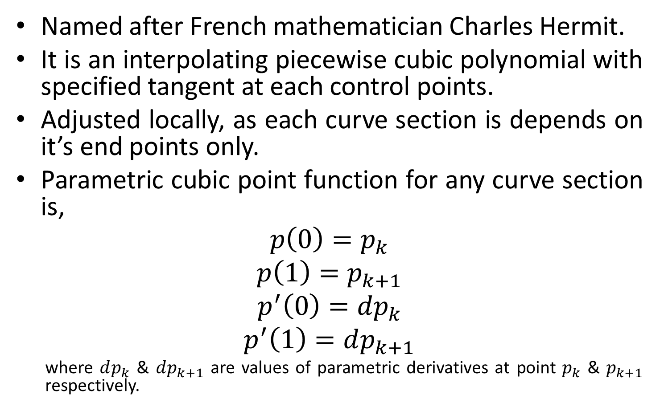
2. Hermit Interpolation
Named after French mathematician Charles Hermit.
It is an interpolating piecewise cubic polynomial with specified tangent at each control points.
Adjusted locally, as each curve section is depends on it’s end points only.
Parametric cubic point function for any curve section is,
$$p\left(0\right)=p_{k}$$
$$p\left(1\right)=p_{k+1}$$
$$p^{′}\left(0\right)={dp}_{k}$$
$$p^{′}\left(1\right)=dp_{k+1}$$
where $dp_{k}$ & $dp_{k+1}$ are values of parametric derivatives at point $p_{k}$ & $p_{k+1}$ respectively.

Slide 41
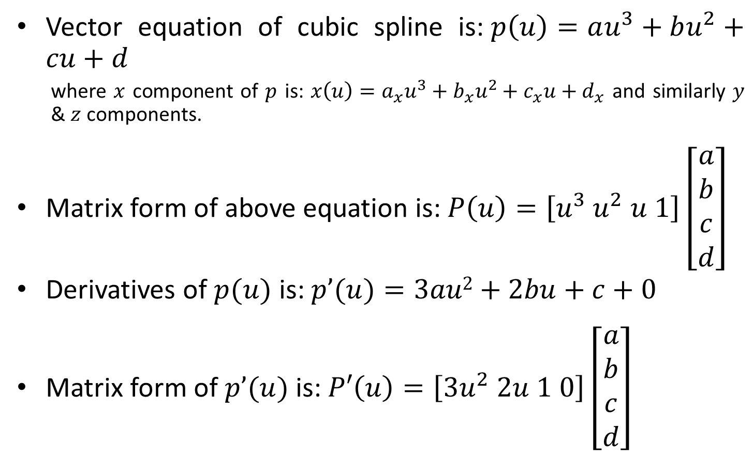
Contd.
Vector equation of cubic spline is:$p\left(u\right)=au^{3}+bu^{2}+cu+d$
where $x$ component of $p$ is: $x\left(u\right)=a_{x}u^{3}+b_{x}u^{2}+c_{x}u+d_{x}$ and similarly $y$ & $z$ components.
Matrix form of above equation is: $P\left(u\right)=\left[u^{3} u^{2} u 1\right]\left[\begin{matrix}a \\ b \\ c \\ d\end{matrix}\right]$
Derivatives of $p(u)$ is: $p’(u)=3au2+2bu+c+0$
Matrix form of $p’(u)$is: $P′\left(u\right)=\left[3u^{2} 2u 1 0\right]\left[\begin{matrix}a \\ b \\ c \\ d\end{matrix}\right]$

Slide 42
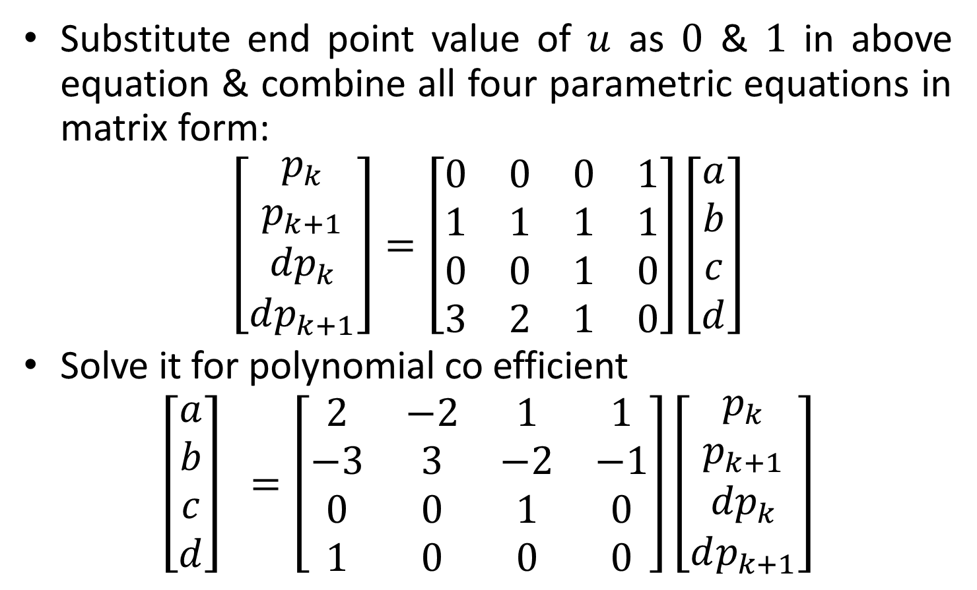
Contd.
Substitute end point value of $u$ as $0$ & $1$ in above equation & combine all four parametric equations in matrix form:
$$\left[\begin{matrix}p_{k} \\ p_{k+1} \\ {dp}_{k} \\ dp_{k+1}\end{matrix}\right]=\left[\begin{matrix}0 & 0 & 0 & 1 \\ 1 & 1 & 1 & 1 \\ 0 & 0 & 1 & 0 \\ 3 & 2 & 1 & 0\end{matrix}\right]\left[\begin{matrix}a \\ b \\ c \\ d\end{matrix}\right]$$
Solve it for polynomial co efficient
$$\left[\begin{matrix}a \\ b \\ c \\ d\end{matrix}\right] =\left[\begin{matrix}2 & −2 & 1 & 1 \\ −3 & 3 & −2 & −1 \\ 0 & 0 & 1 & 0 \\ 1 & 0 & 0 & 0\end{matrix}\right]\left[\begin{matrix}p_{k} \\ p_{k+1} \\ {dp}_{k} \\ dp_{k+1}\end{matrix}\right]$$

Slide 43
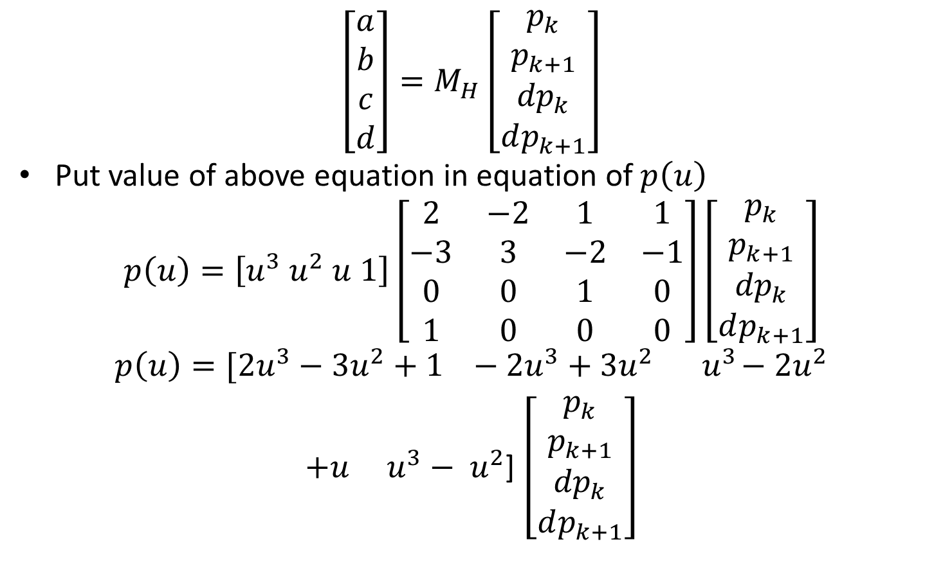
Contd.
$$\left[\begin{matrix}a \\ b \\ c \\ d\end{matrix}\right]=M_{H}\left[\begin{matrix}p_{k} \\ p_{k+1} \\ {dp}_{k} \\ dp_{k+1}\end{matrix}\right]$$
Put value of above equation in equation of$p\left(u\right)$
$$p\left(u\right)=\left[u^{3} u^{2} u 1\right]\left[\begin{matrix}2 & −2 & 1 & 1 \\ −3 & 3 & −2 & −1 \\ 0 & 0 & 1 & 0 \\ 1 & 0 & 0 & 0\end{matrix}\right]\left[\begin{matrix}p_{k} \\ p_{k+1} \\ {dp}_{k} \\ dp_{k+1}\end{matrix}\right]$$
$$p\left(u\right)=[2u^{3}−3u^{2}+1 −2u^{3}+3u^{2} { u}^{3}−2u^{2}$$
$+u u^{3}− u^{2}$]$\left[\begin{matrix}p_{k} \\ p_{k+1} \\ {dp}_{k} \\ dp_{k+1}\end{matrix}\right]$

Slide 44
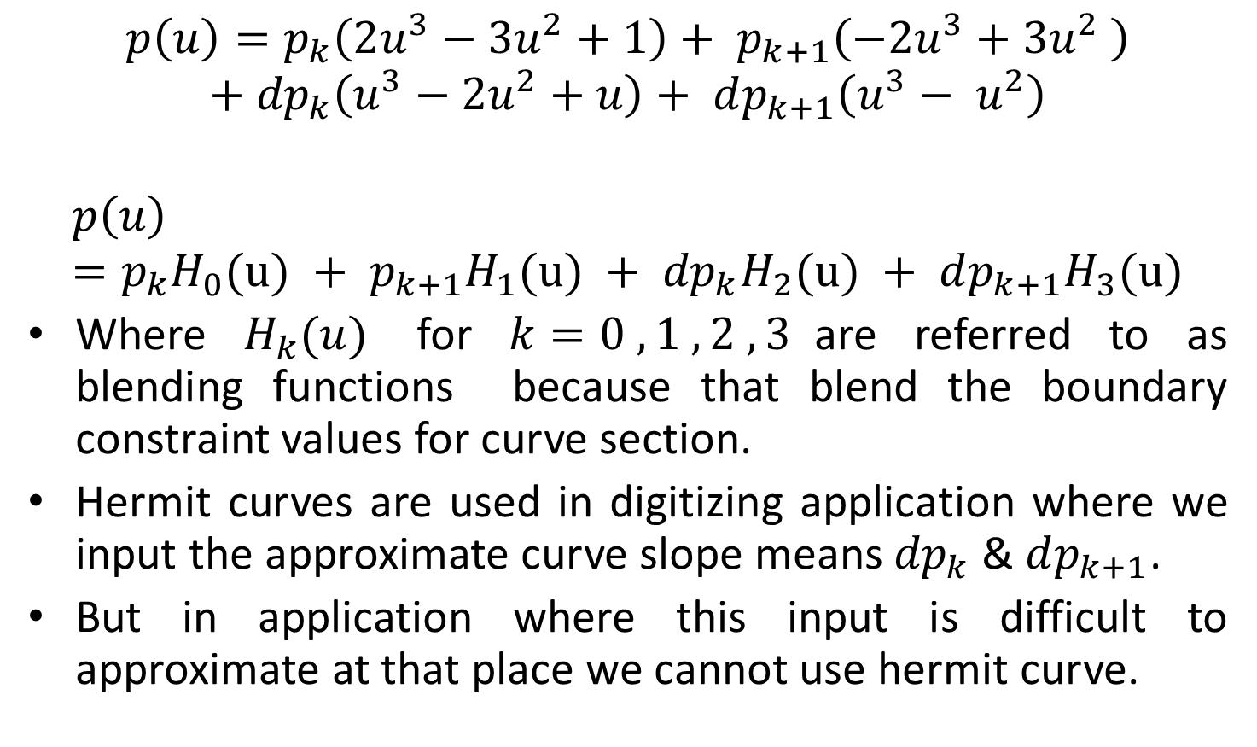
Contd.
$$p\left(u\right)=p_{k}\left(2u^{3}−3u^{2}+1\right)+ p_{k+1}\left(−2u^{3}+3u^{2} \right)$$
$$+ {dp}_{k}\left(u^{3}−2u^{2}+u\right)+ dp_{k+1}\left(u^{3}− u^{2}\right)$$
$$p\left(u\right)=p_{k}H_{0}(u) + {p_{k+1}H}_{1}(u) + {dp}_{k}H_{2}(u) + {dp_{k+1}H}_{3}(u)$$
Where $H_{k}(u)$ for $k=0 , 1 , 2 , 3$are referred to as blending functions because that blend the boundary constraint values for curve section.
Hermit curves are used in digitizing application where we input the approximate curve slope means ${dp}_{k}$ & $dp_{k+1}$.
But in application where this input is difficult to approximate at that place we cannot use hermit curve.

Slide 45





3. Cardinal Splines
As like hermit spline cardinal splines also interpolating piecewise cubic with specified endpoint tangents at the boundary of each section.
But in this spline we need not have to input the values of endpoint tangents.
In cardinal spline values of slope at control point is calculated from two immediate neighbour control points.
It’s spline section
is completely specified by the
4-control points.
$$p_{k}$$
$$p(u)$$
$$p_{k+1}$$
$$p_{k−1}$$
$$p_{k+2}$$

Slide 46
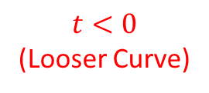


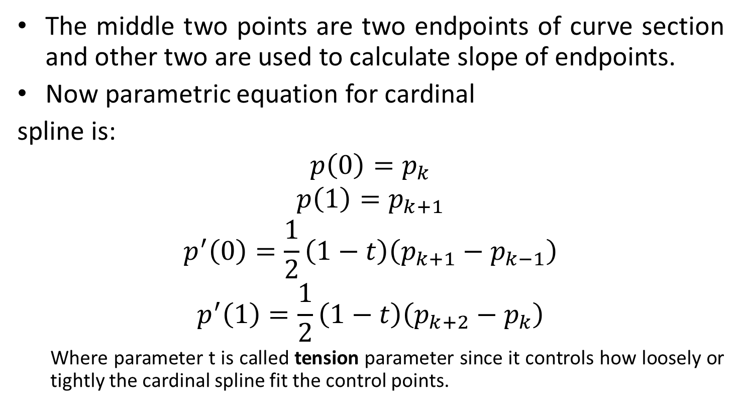



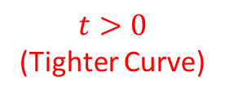
Contd.
The middle two points are two endpoints of curve section and other two are used to calculate slope of endpoints.
Now parametric equation for cardinal
spline is:
$$p\left(0\right)=p_{k}$$
$$p\left(1\right)=p_{k+1}$$
$$p^{′}\left(0\right)=\frac{1}{2}\left(1−t\right)\left(p_{k+1}−p_{k−1}\right)$$
$$p^{′}\left(1\right)=\frac{1}{2}\left(1−t\right)\left(p_{k+2}−p_{k}\right)$$
Where parameter t is called tension parameter since it controls how loosely or tightly the cardinal spline fit the control points.
$$p_{k}$$
$$p(u)$$
$$p_{k+1}$$
$$p_{k−1}$$
$$p_{k+2}$$
$$t<0$$
(Looser Curve)
$$t>0$$
(Tighter Curve)

Slide 47
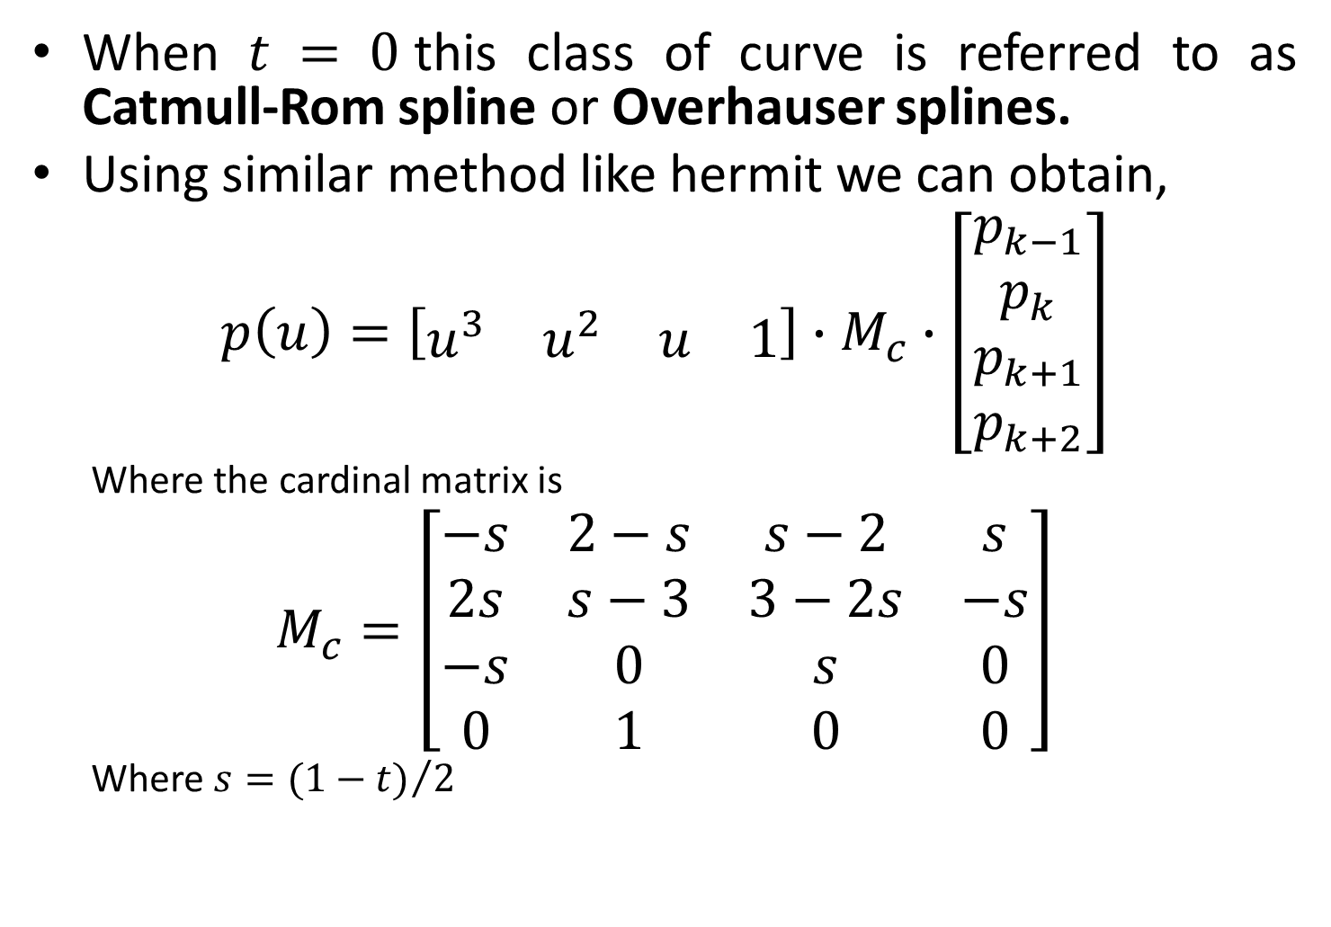
Contd.
When $t = 0$this class of curve is referred to as Catmull-Rom spline or Overhauser splines.
Using similar method like hermit we can obtain,
$$p\left(u\right)=\left[\begin{matrix}u^{3} & u^{2} & u & 1\end{matrix}\right]∙M_{c}∙\left[\begin{matrix}p_{k−1} \\ p_{k} \\ p_{k+1} \\ p_{k+2}\end{matrix}\right]$$
Where the cardinal matrix is
$$M_{c}=\left[\begin{matrix}−s & 2−s & s−2 & s \\ 2s & s−3 & 3−2s & −s \\ −s & 0 & s & 0 \\ 0 & 1 & 0 & 0\end{matrix}\right]$$
Where $s={(1−t)}/2$

Slide 48

Contd.
Put value of $Mc$ in equation of $p(u)$
$$p\left(u\right)=\left[\begin{matrix}u^{3} & u^{2} & u & 1\end{matrix}\right]∙\left[\begin{matrix}−s & 2−s & s−2 & s \\ 2s & s−3 & 3−2s & −s \\ −s & 0 & s & 0 \\ 0 & 1 & 0 & 0\end{matrix}\right]∙\left[\begin{matrix}p_{k−1} \\ p_{k} \\ p_{k+1} \\ p_{k+2}\end{matrix}\right]$$
$$p\left(u\right)=\left[\begin{matrix}−su^{3}+2su^{2}−su & \left(2−s\right)u^{3}+\left(s−3\right)u^{2}+1 & \left(s−2\right)u^{3}+\left(3−s\right)u^{2}+su & su^{3}−su^{2}\end{matrix}\right]∙\left[\begin{matrix}p_{k−1} \\ p_{k} \\ p_{k+1} \\ p_{k+2}\end{matrix}\right]$$

Slide 49
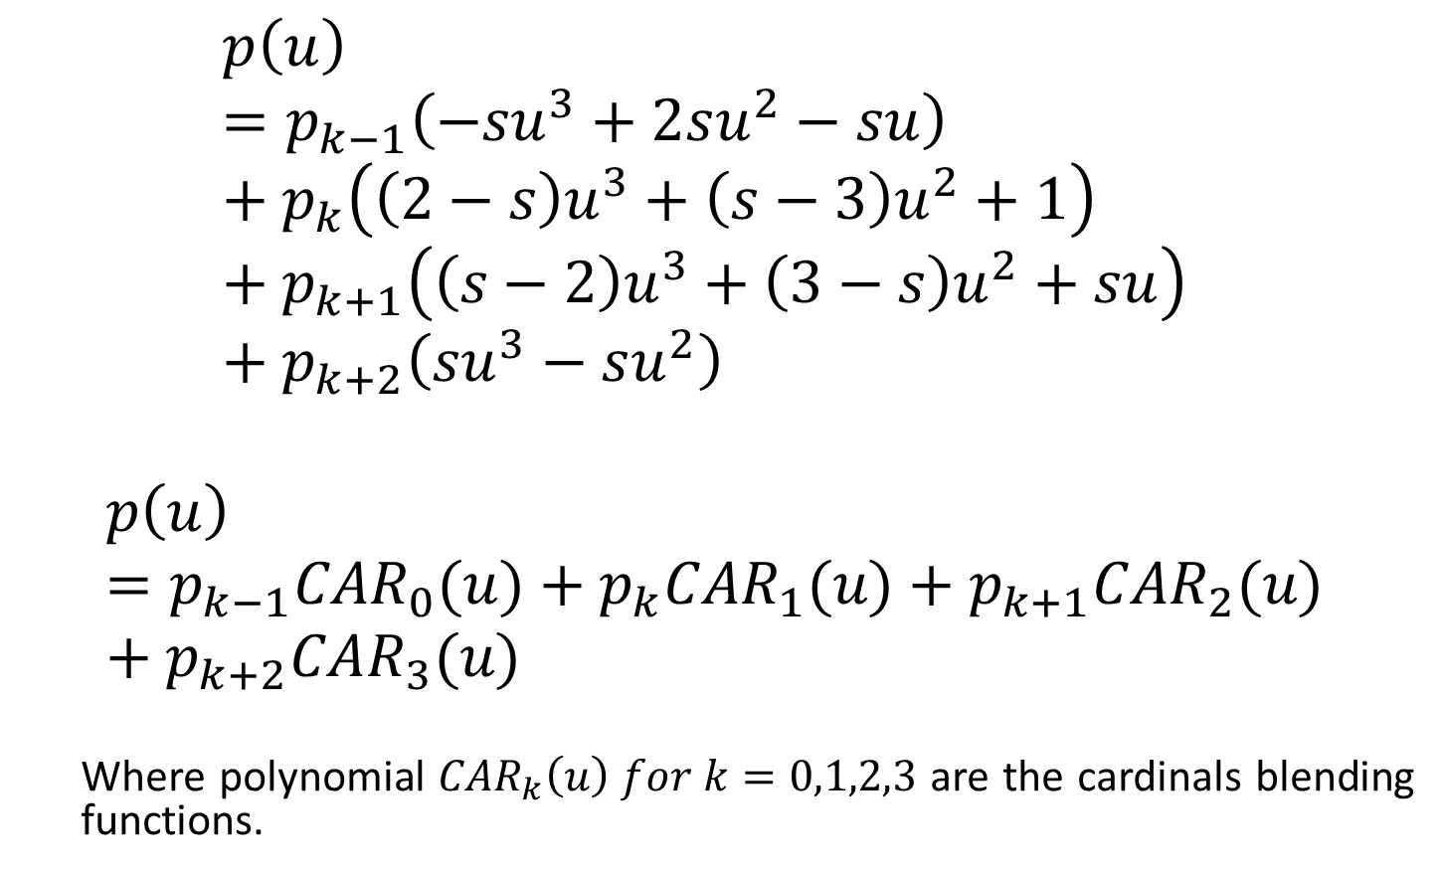
Contd.
$$p\left(u\right)=p_{k−1}\left(−su^{3}+2su^{2}−su\right)+p_{k}\left(\left(2−s\right)u^{3}+\left(s−3\right)u^{2}+1\right)+p_{k+1}\left(\left(s−2\right)u^{3}+\left(3−s\right)u^{2}+su\right) +p_{k+2}\left(su^{3}−su^{2}\right)$$
$$p\left(u\right)=p_{k−1}{CAR}_{0}(u)+p_{k}{CAR}_{1}(u)+p_{k+1}{CAR}_{2}(u)+p_{k+2}{CAR}_{3}(u)$$
Where polynomial ${CAR}_{k}\left(u\right) for k=0,1,2,3$ are the cardinals blending functions.

Slide 50
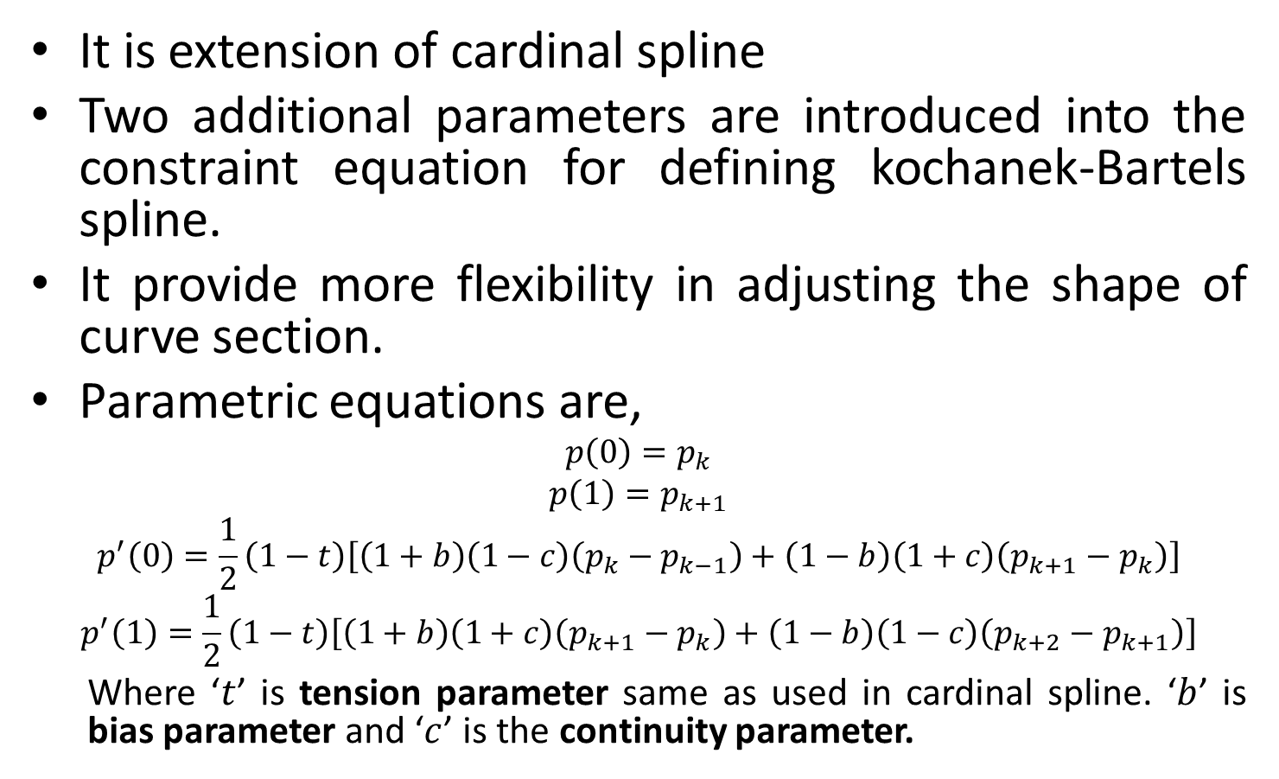
4. Kochanek-Bartels Spline
It is extension of cardinal spline
Two additional parameters are introduced into the constraint equation for defining kochanek-Bartels spline.
It provide more flexibility in adjusting the shape of curve section.
Parametric equations are,
$$p\left(0\right)=p_{k}$$
$$p\left(1\right)=p_{k+1}$$
$$p^{′}\left(0\right)=\frac{1}{2}\left(1−t\right)\left[\left(1+b\right)\left(1−c\right)\left(p_{k}−p_{k−1}\right)+\left(1−b\right)\left(1+c\right)\left(p_{k+1}−p_{k}\right)\right]$$
$$p^{′}\left(1\right)=\frac{1}{2}\left(1−t\right)\left[\left(1+b\right)\left(1+c\right)\left(p_{k+1}−p_{k}\right)+\left(1−b\right)\left(1−c\right)\left(p_{k+2}−p_{k+1}\right)\right]$$
Where ‘$t$’ is tension parameter same as used in cardinal spline. ‘$b$’ is bias parameter and ‘$c$’ is the continuity parameter.

Slide 51
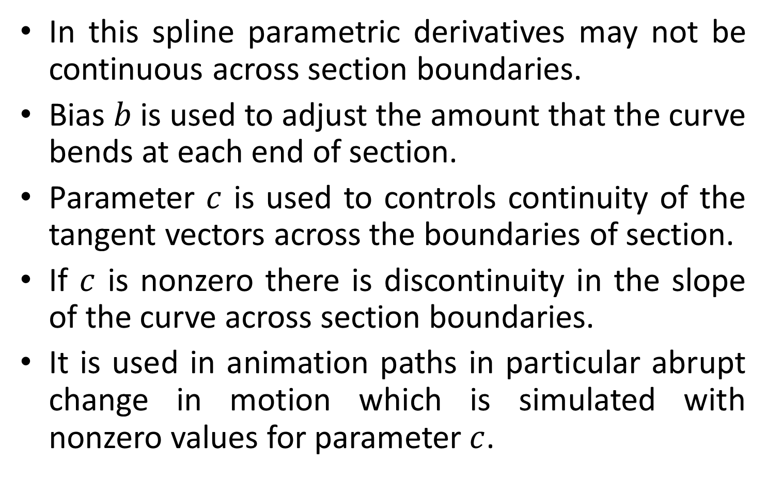
Contd.
In this spline parametric derivatives may not be continuous across section boundaries.
Bias $b$ is used to adjust the amount that the curve bends at each end of section.
Parameter $c$ is used to controls continuity of the tangent vectors across the boundaries of section.
If $c$ is nonzero there is discontinuity in the slope of the curve across section boundaries.
It is used in animation paths in particular abrupt change in motion which is simulated with nonzero values for parameter $c$.

Slide 52
Thank You

